Slide 1






MIRRORS SPA HOTEL
Book Now:
Visit our website at www.mirrors.com or call us at +1-800-HOTEL-INFO.
Don’t miss out on this extraordinary escape. MIRROR Hotel—where dreams come true! ✨🏨

Slide 2

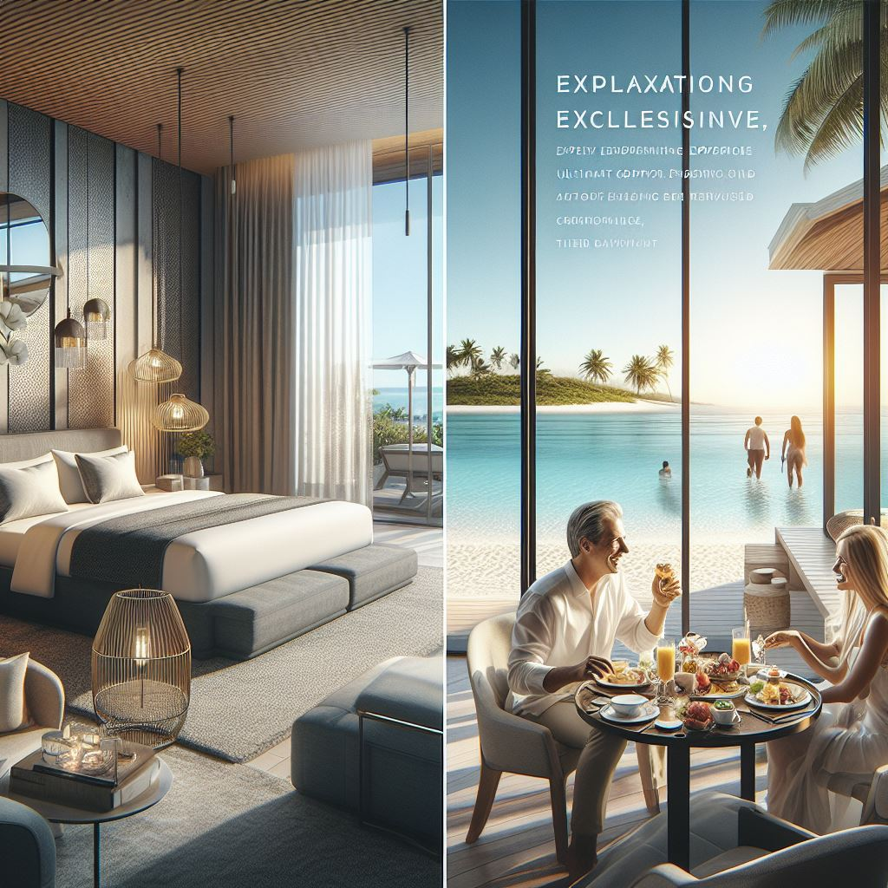
НАЙДИТЕ СВОЕ УВЛЕЧЕНИЕ
Рыбалка
Прогулки
Походы
Плавание под парусами

Slide 3
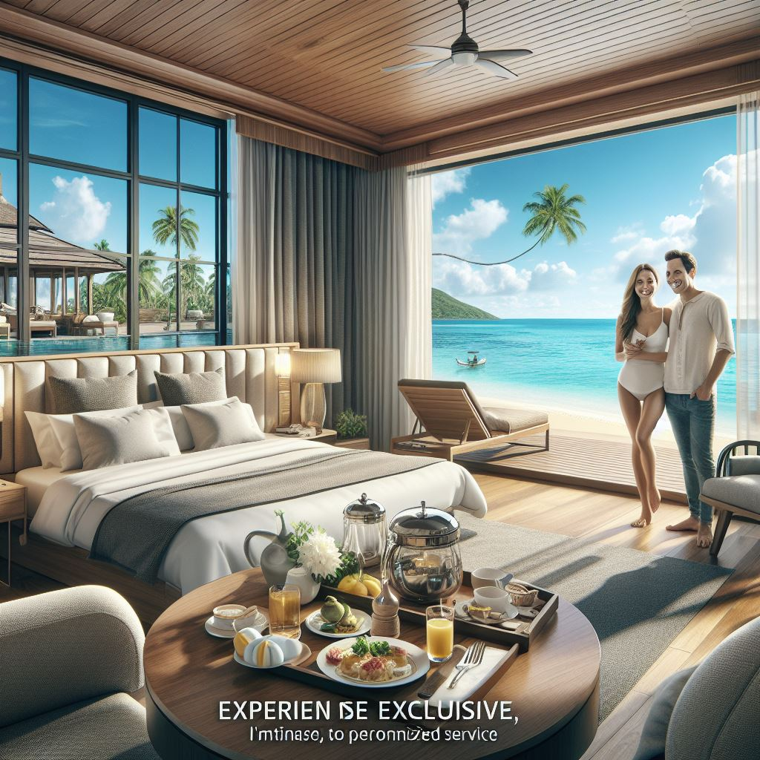
# 🌟 Mirrors Hotel Deals! 🌟 ## Stay with Us and Enjoy: 1. **50% Off Spa Services**: Relax and rejuvenate in our luxurious spa. 2. **Complimentary Breakfast Buffet**: Start your day with a delicious spread. 3. **Upgrade to a Suite**: Book a standard room, get upgraded to a suite! 4. **Late Checkout**: Enjoy a leisurely departure until 2:00 PM. !Hotel Image Book now at www.mirrors.com or call us at +1-800-HOTEL-INFO. Don't miss out! Limited availability. Terms and conditions apply.

Slide 4
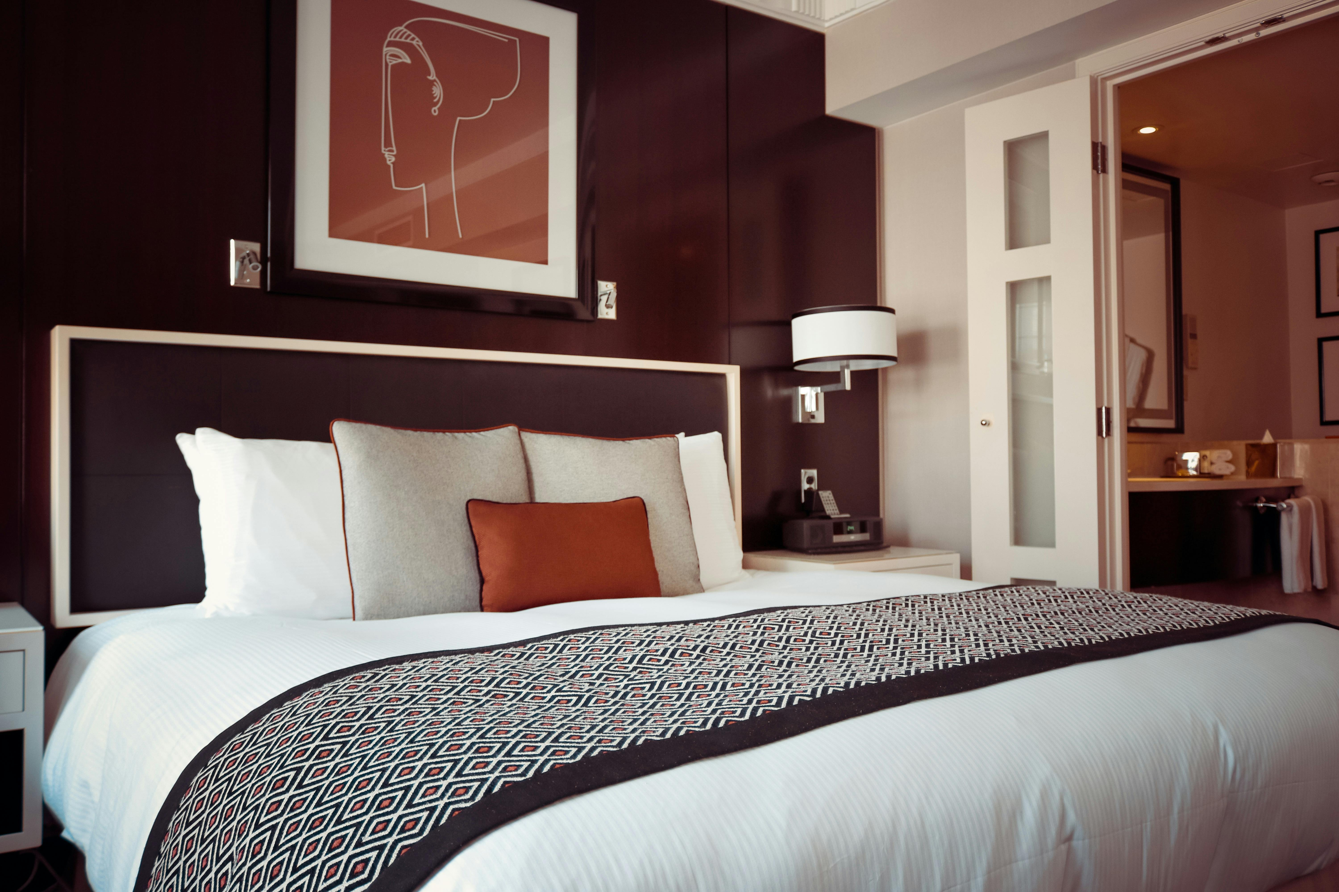
ДОСТИЖЕНИЕ ЦЕЛИ

Slide 5

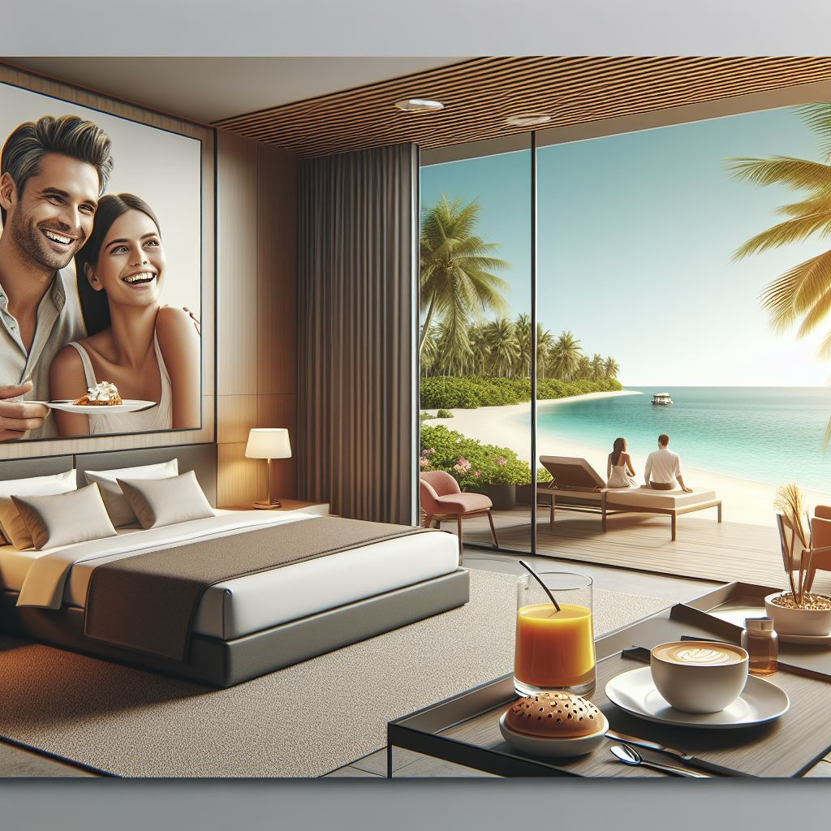
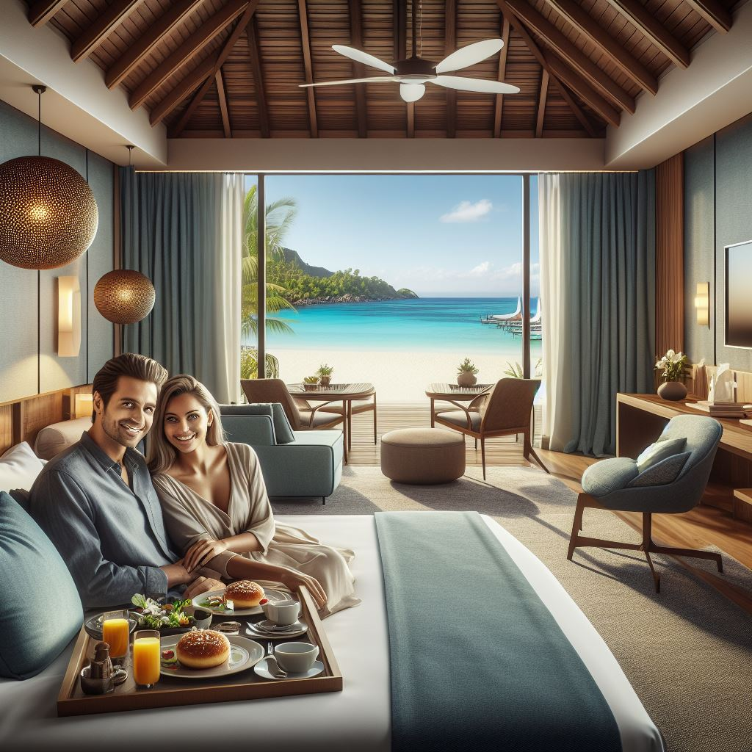

НАШИ КОНТАКТЫ
proverka@example.com

